Slide 1
CS 152 Computer Architecture and Engineering CS252A Graduate Computer Architecture Lecture 1 - Introduction
Krste Asanovic
Electrical Engineering and Computer Sciences
University of California at Berkeley
http://people.eecs.berkeley.edu/~krste
http://inst.eecs.berkeley.edu/~cs152

Slide 2
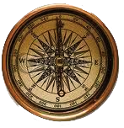
What is Computer Architecture?
Application
Gap too large to bridge in one step
(but there are exceptions, e.g. magnetic compass)
Physics
In its broadest definition, computer architecture is the design of the abstraction layers that allow us to implement information processing applications efficiently using available manufacturing technologies.

Slide 3
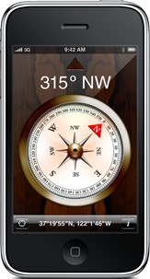
Abstraction Layers in Modern Systems
应用层 Application
算法层 Algorithm
编程语言层 Programming Language
操作系统/虚拟机层 Operating System/Virtual Machines
指令集架构层 Instruction Set Architecture (ISA)
微体系结构层 Microarchitecture
门/寄存器 转换层Gates/Register-Transfer Level (RTL)
电路层 Circuits
设备层 Devices
物理层 Physics

Slide 4
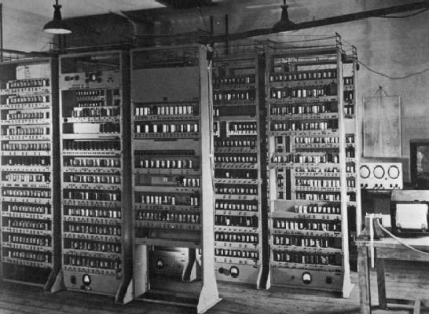
Computing Devices Then…
EDSAC, University of Cambridge, UK, 1949
电子延时储存自动计算器（Electronic Delay Storage Automatic Computer）

Slide 5

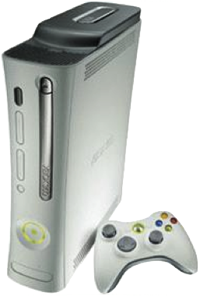
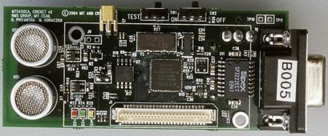
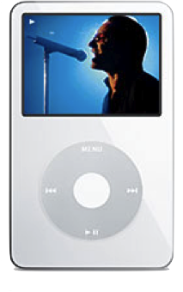
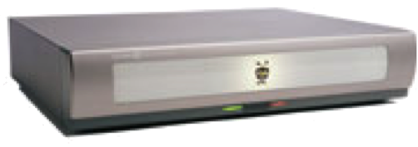
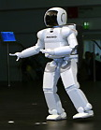
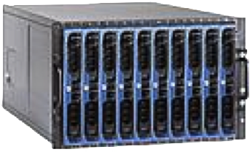
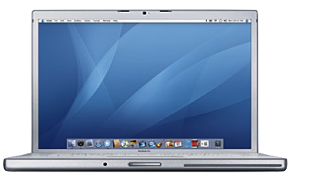
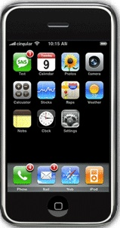
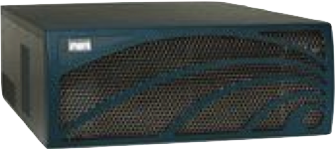
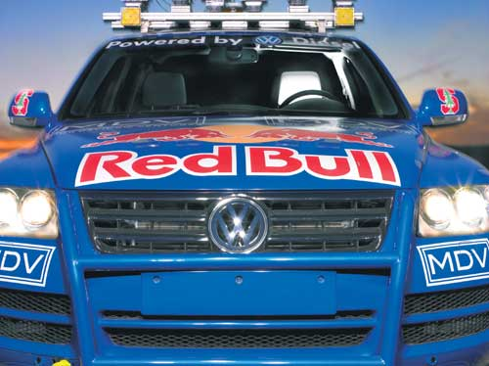
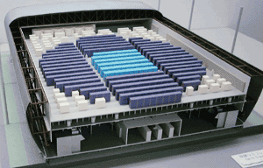
Computing Devices Now
Sensor Nets
Cameras
Games
Set-top boxes
Media Players
Laptops
Servers
Routers
Robots
Smart phones
Automobiles
Supercomputers

Slide 6
Architecture continually changing
Applications suggest how to improve technology, provide revenue to fund development
Improved technologies make new applications possible
Applications
Technology
Cost of software development makes compatibility a major force in market
Compatibility

Slide 7
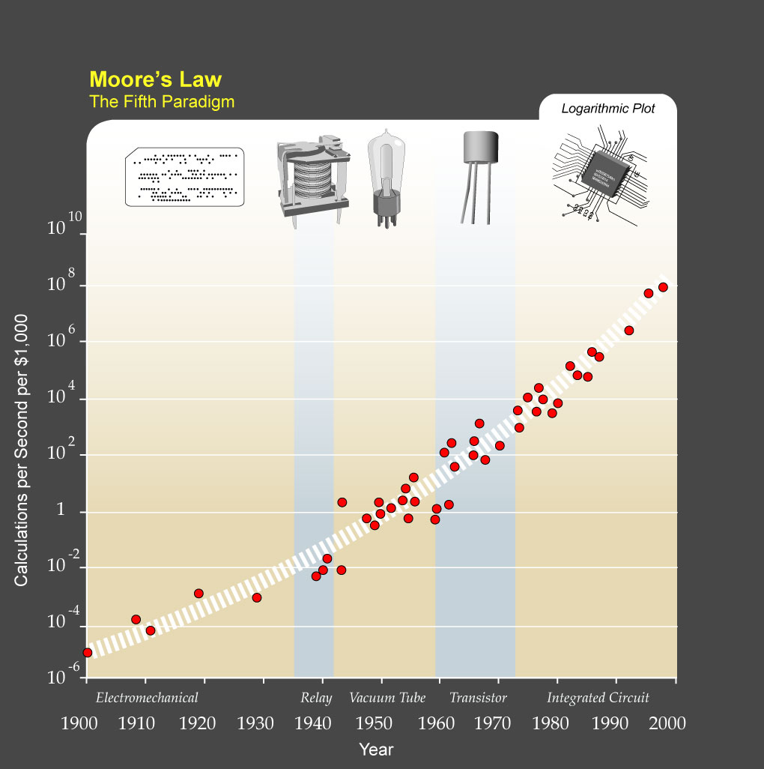
?
Major Technology Generations
CMOS
Bipolar
nMOS
Vacuum Tubes
pMOS
Relays
[from Kurzweil]
Electromechanical

Slide 8
Single-Thread Processor Performance
[ Hennessy & Patterson, 2017 ]

Slide 9
Upheaval in Computer Design
Most of last 50 years, Moore’s Law ruled
Technology scaling allowed continual performance/energy improvements without changing software model
Last decade, technology scaling slowed/stopped
Dennard (voltage) scaling over (supply voltage ~fixed)
Moore’s Law (cost/transistor) over?
No competitive replacement for CMOS anytime soon
Energy efficiency constrains everything
No “free lunch” for software developers, must consider:
Parallel systems
Heterogeneous systems

Slide 10
Today’s Dominant Target Systems
Mobile (smartphone/tablet)
>1 billion sold/year
Market dominated by ARM-ISA-compatible general-purpose processor in system-on-a-chip (SoC)
Plus sea of custom accelerators (radio, image, video, graphics, audio, motion, location, security, etc.)
Warehouse-Scale Computers (WSCs)
100,000’s cores per warehouse
Market dominated by x86-compatible server chips
Dedicated apps, plus cloud hosting of virtual machines
Now seeing increasing use of GPUs, FPGAs, custom hardware to accelerate workloads
Embedded computing
Wired/wireless network infrastructure, printers
Consumer TV/Music/Games/Automotive/Camera/MP3
Internet of Things!

Slide 11
New Vertical Semiconductor Business Model
Instead of buying chip company’s standard product, chip customers build own differentiated designs:
Apple, Samsung, Qualcomm, Huawei for phones
Google, Amazon, Alibaba, Microsoft, for client/cloud
Tesla, Cruize for car
IoT products, FitBit, Apple for wearables
End-system value/profit justifies cost of chip design
can be >>$100M engineering cost to develop a new advanced chip!

Slide 12
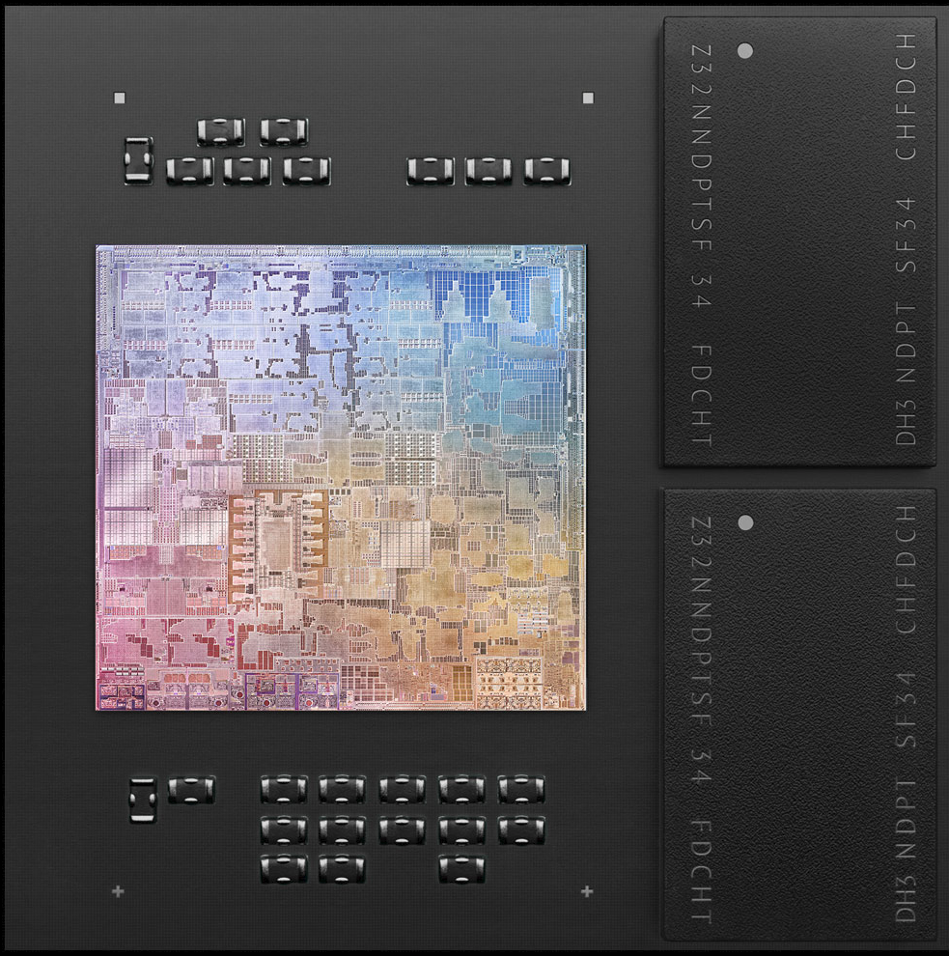
Apple M1
[© Apple]

Slide 13
This Year: Combined CS152/CS252A, all remote
CS152/CS252A share lectures in virtual MW 9:00am-10:30am
Zoom links given in Piazza-pinned post, lectures start at 9:10am (Berkeley Time)
Lectures will be recorded/webcast
For CS252A students, initial lectures are optional review material
some lectures include CS252A-only material
CS152/CS252A share two midterms (during class, 80 minutes each)
but some questions marked as CS152 only or CS252 only
CS152 has problem sets
CS252A students welcome to use PS for revision, self-learning
CS152 has labs
CS252A students welcome to use labs for self-learning
CS152 has discussion sections
CS152 has final exam
CS252A has paper readings with discussion (Thu 5-6pm)
CS252A has course projects with final presentation/paper

Slide 14
Course Conflicts
This class does not support conflicts with other classes
Webcast is to provide additional resource for students
We will not be accommodating midterm/final exam conflicts due to taking overlapping class
Other documented conflicts will be supported
Large documented timezone difference will be accommodated

Slide 15
CS152/CS252A Administrivia
Instructor: Prof. Krste Asanovic, krste@berkeley.edu
Zoom Office Hours: Tue 10-11AM (email to confirm)
T. A.s: Albert Ou, aou@eecs OH: TBD, respond to poll on Piazza
Jerry Zhao, jzh@berkeley OH: TBD, respond to poll on Piazza
Lectures: MW, 9:10AM-10:30AM, Live stream over zoom, and webcast
252A Readings discussion: Thursday 5-6pm, Zoom meeting, see 252 Piazza
152 Sections (begin Friday 1/31):
Friday 12:00-2:00pm DIS 101, over Zoom
Friday 2:00-4:00pm DIS 102, over Zoom
Text: Computer Architecture: A Quantitative Approach, Hennessey and Patterson, 6th Edition (2017)
Readings assigned from this edition, some readings available in older editions – see web page.
Web page: http://inst.eecs.berkeley.edu/~cs152
Lectures available online by 8am before class
Piazza: http://piazza.com/berkeley/spring2021/cs152
http://piazza.com/berkeley/spring2021/cs252
Notes:
This slide is for the 3-min class administrative matters.
Make sure we update Handout #1 so it is consistent with this slide.

Slide 16
CS152 Course Grading
15% Problem Sets
Intended to help you learn the material. Feel free to discuss with other students and instructors, but you must turn in your own solutions. Grading based mostly on effort, but exams assume that you have worked through all problems. Solutions released after PSs handed in.
25% Labs
Labs use advanced full architectural simulators
Directed plus open-ended sections to each lab
Must complete at least three labs else automatic F grade
60% Exams (two midterms plus final, 15%+15%+30%)
Closed-book, no calculators, no smartphones, no smartwatch, no laptops,...
Based on lectures, readings, problem sets, and labs
Remote proctoring protocol TBD

Slide 17
CS252 Course Grading
20% Paper readings
Paper summaries, discussion participation
30% Exams (two midterms, 15%+15%)
Closed-book, no calculators, no smartphones, no smartwatch, no laptops,...
Based on lectures, readings, problem sets, and labs
50% Class Project
Substantial research project in pairs, regular 1-1 meetings with staff, 10-page conference-style paper and class presentation,

Slide 18
CS152/CS252A Crossovers
Berkeley undergrads cannot take CS252A
CS152 students can participate in CS252A paper readings if room, but can not submit responses
CS152 students can do a class project but won’t be graded
CS152 students welcome to attend CS252A final project presentations
CS252A students can complete PSs but won’t be graded
CS252A students can take labs but won’t be graded
CS252A students can attend discussion sections

Slide 19
CS152 Labs
Each lab has directed plus open-ended assignments
Directed portion (~30%) is intended to ensure students learn main concepts behind lab
Each student must perform own lab and hand in their own lab report
Open-ended assignment (~70%) is to allow you to show your creativity
Roughly a one-day “mini-project”
E.g., try an architectural idea and measure potential, negative results OK (if explainable!)
Students can work individually or in groups of two or three
Group open-ended lab reports must be handed in separately
Students can work in different groups for different assignments
Lab reports must be readable English summaries – not dumps of log files!!!!!!
We will reward good reports, and penalize undecipherable reports

Slide 20
RISC-V is class ISA
RISC-V is a new free, simple, clean, extensible ISA we developed at Berkeley for education (61C/151/152/252) and research (ParLab/ASPIRE/ADEPT)
RISC-I/II, first Berkeley RISC implementations
Berkeley research machines SOAR/SPUR considered RISC-III/IV
Both of the dominant ISAs (x86 and ARM) are too complex to use for teaching or research
RISC-V has taken off commercially
RISC-V Foundation manages standard riscv.org
Now upstream support for many tools (gcc, Linux, FreeBSD, …)
Nvidia is using RISC-V in all future GPUs
Western Digital is using RISC-V in all future products
Samsung, Qualcomm, Google, many others using RISC-V

Slide 21
Chisel simulators
Chisel is a new hardware description language we developed at Berkeley based on Scala
Constructing Hardware in a Scala Embedded Language
Labs will use RISC-V processor simulators derived from Chisel processor designs
Gives you much more detailed information than other simulators
Can map to FPGA or real chip layout
You need to learn some minimal Chisel in CS152, but we’ll make Chisel RTL source available so you can see all the details of our processors
Can do lab projects based on modifying the Chisel RTL code if desired
This year, we’ll be using Chipyard infrastructure for labs:
https://chipyard.readthedocs.io/en/latest/

Slide 22
Chisel Design Flow
Chisel Design Description
Chisel Compiler
FPGA Verilog
ASIC Verilog
FPGA Tools
ASIC Tools
FPGA Emulation
GDS Layout

Slide 23
Questions?

Slide 24
Computer Architecture: A Little History
Throughout the course we’ll use a historical narrative to help understand why certain ideas arose
Why worry about old ideas?
Helps to illustrate the design process, and explains why certain decisions were taken
Because future technologies might be as constrained as older ones
Those who ignore history are doomed to repeat it
Every mistake made in mainframe design was also made in minicomputers, then microcomputers, where next?

Slide 25
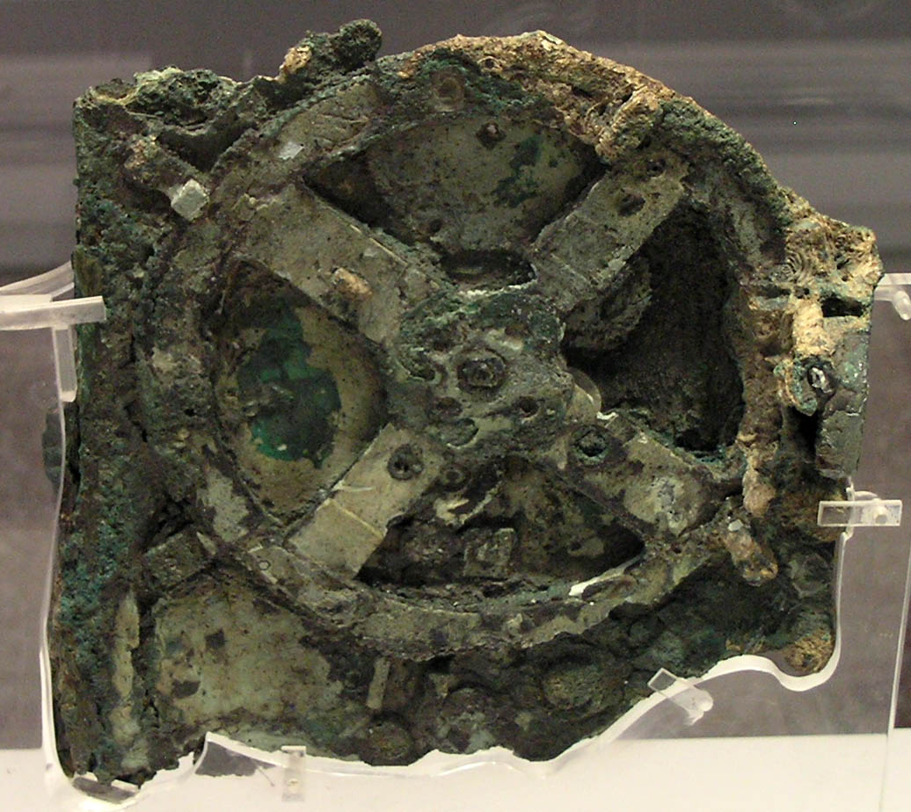
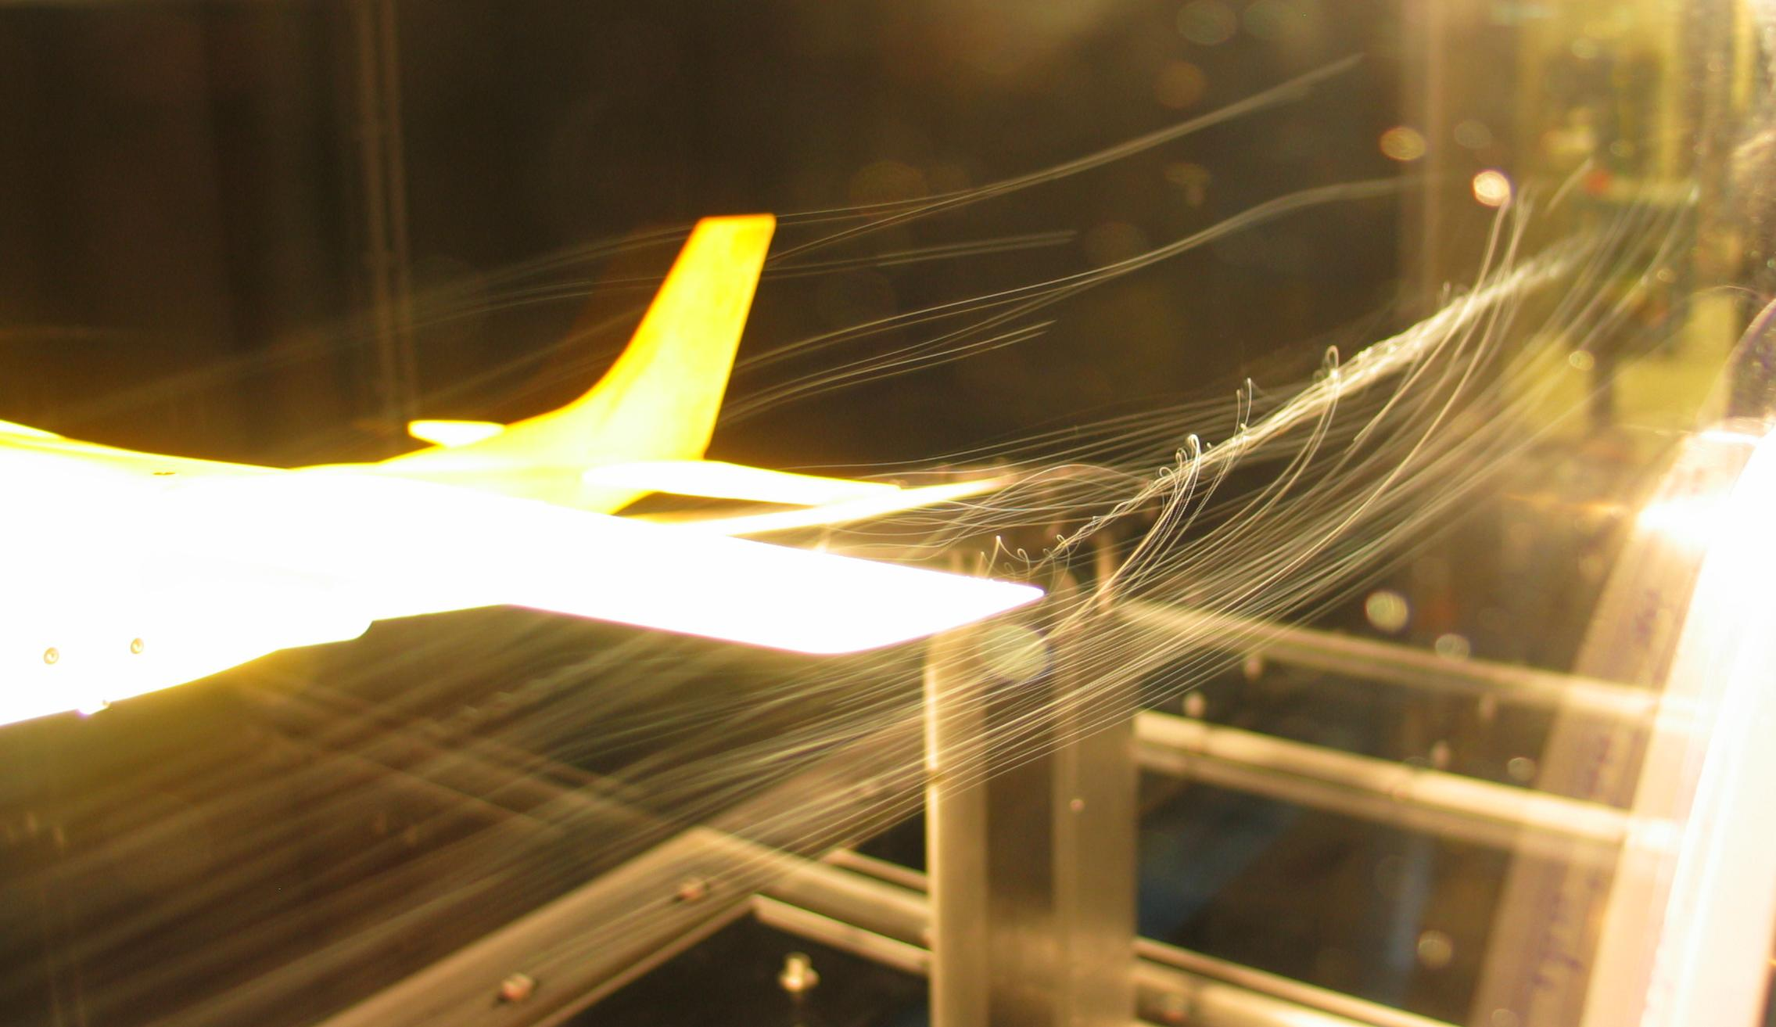
Analog Computers
Analog computer represents problem variables as some physical quantity (e.g., mechanical displacement, voltage on a capacitor) and uses scaled physical behavior to calculate results
[BenFrantzDale, Creative Commons BY-SA 3.0]
[Marsyas, Creative Commons BY-SA 3.0]
Wingtip vortices off Cesna tail in wind tunnel
Antikythera mechanism c.100BC

Slide 26
Digital Computers
Represent problem variables as numbers encoded using discrete steps
Discrete steps provide noise immunity
Enables accurate and deterministic calculations
Same inputs give same outputs exactly
Not constrained by physically realizable functions
Programmable digital computers are CSx52 focus

Slide 27
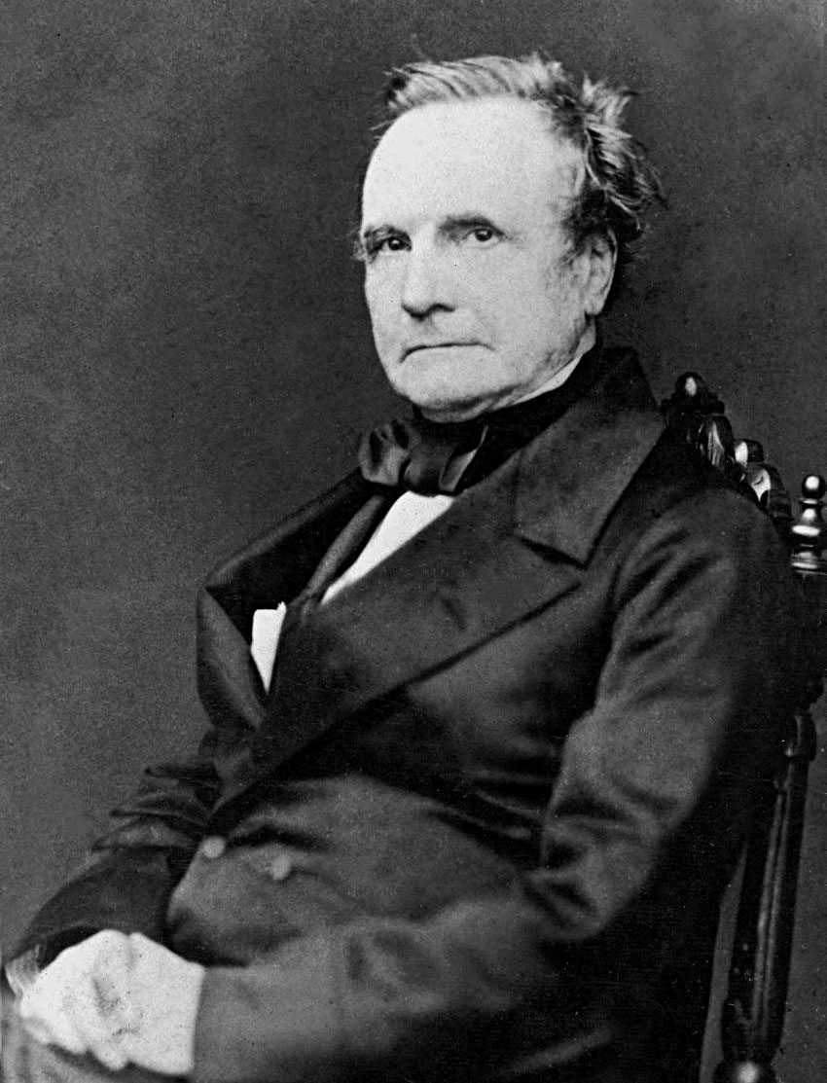
Charles Babbage (1791-1871)
Lucasian Professor of Mathematics, Cambridge University, 1828-1839
A true “polymath” with interests in many areas
Frustrated by errors in printed tables, wanted to build machines to evaluate and print accurate tables
Inspired by earlier work organizing human “computers” to methodically calculate tables by hand
[Copyright expired and in public domain.
Image obtained from Wikimedia Commons.]

Slide 28
Difference Engine 1822
Continuous functions can be approximated by polynomials, which can be computed from difference tables:
f(n) = n² + n + 41
d1(n) = f(n) – f(n-1) = 2n
d2(n) = d1(n) – d1(n-1) = 2
Can calculate using only a single adder:
n
0
1
2
3
4
d2(n)
2
2
2
d1(n)
2
4
6
8
f(n)
41
43
47
53
61

Slide 29
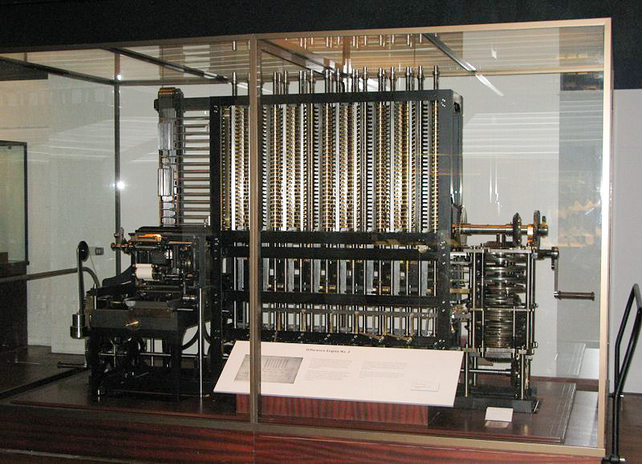
Realizing the Difference Engine
Mechanical calculator, hand-cranked, using decimal digits
Babbage did not complete the DE, moving on to the Analytical Engine (but used ideas from AE in improved DE 2 plan)
Schuetz in Sweden completed working version in 1855, sold copy to British Government
Modern day recreation of DE2, including printer, showed entire design possible using original technology
first at British Science Museum
copy at Computer History Museum in San Jose
[Geni, Creative Commons BY-SA 3.0 ]

Slide 30
Analytical Engine 1837
Recognized as first general-purpose digital computer
Many iterations of the design (multiple Analytical Engines)
Contains the major components of modern computers:
“Store”: Main memory where numbers and intermediate results were held (1,000 decimal words, 40-digits each)
“Mill”: Arithmetic unit where processing was performed including addition, multiplication, and division
Also supported conditional branching and looping, and exceptions on overflow (machine jams and bell rings)
Had a form of microcode (the “Barrel”)
Program, input and output data on punched cards
Instruction cards hold opcode and address of operands in store
3-address format with two sources and one destination, all in Store
Branches implemented by mechanically changing order cards were inserted into machine
Only small pieces were ever built

Slide 31
Analytical Engine Design Choices
Decimal, because storage on mechanical gears
Babbage considered binary and other bases, but no clear advantage over human-friendly decimal
40-digit precision (equivalent to >133 bits)
To reduce impact of scaling given lack of floating-point hardware
Used “locking” or mechanical amplification to overcome noise in transferring mechanical motion around machine
Similar to non-linear gain in digital electronic circuits
Had a fast “anticipating” carry
Mechanical version of pass-transistor carry propagate used in CMOS adders (and earlier in relay adders)

Slide 32
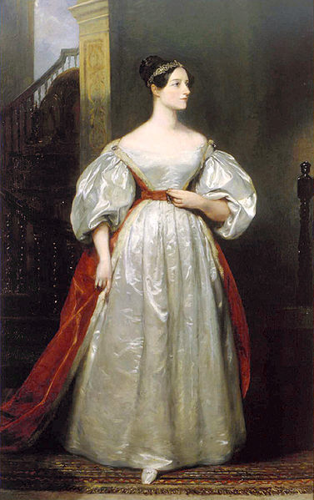
Ada Lovelace (1815-1852)
Translated lectures of Luigi Menabrea who published notes of Babbage’s lectures in Italy
Lovelace considerably embellished notes and described Analytical Engine program to calculate Bernoulli numbers that would have worked if AE was built
The first program!
Imagined many uses of computers beyond calculations of tables
Was interested in modeling the brain!
[By Margaret Sarah Carpenter,
Copyright expired and in public domain]

Slide 33
Early Programmable Calculators
Analog computing was popular in first half of 20th century as digital computing was too expensive
But during late 30s and 40s, several programmable digital calculators were built (date when operational)
Atanasoff Linear Equation Solver (1939)
Zuse Z3 (1941)
Harvard Mark I (1944)
ENIAC (1946)

Slide 34
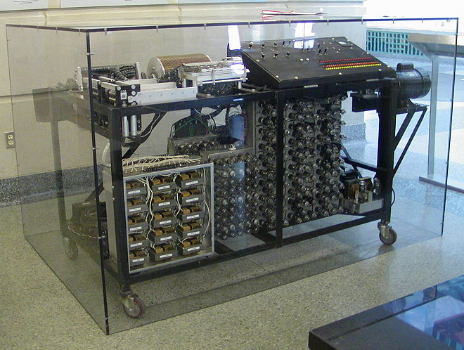
Atanasoff-Berry Linear Equation Solver (1939)
Fixed-function calculator for solving up to 29 simultaneous linear equations
Digital binary arithmetic (50-bit fixed-point words)
Dynamic memory (rotating drum of capacitors)
Vacuum tube logic for processing
In 1973, Atanasoff was credited as inventor of “automatic electronic digital computer” after patent dispute with Eckert and Mauchly (ENIAC)
[Manop, Creative Commons BY-SA 3.0 ]

Slide 35
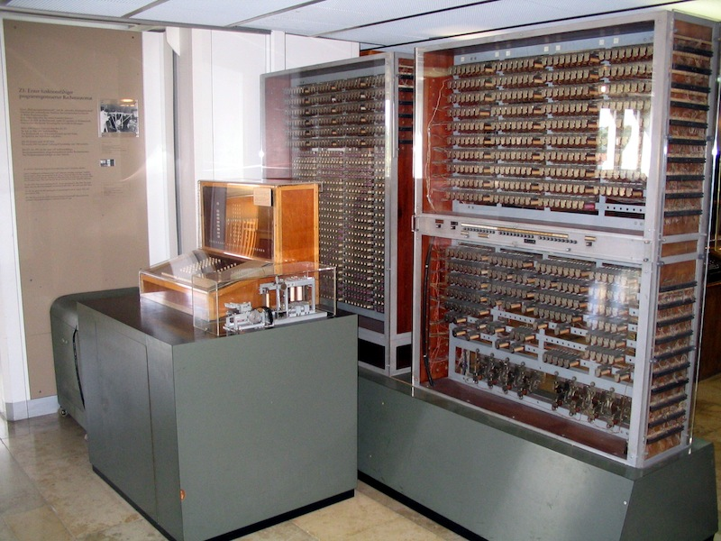
Zuse Z3 (1941)
Built by Konrad Zuse in wartime Germany using 2000 relays
Had normalized floating-point arithmetic with hardware handling of exceptional values (+/- infinity, undefined)
1-bit sign, 7-bit exponent, 14-bit significand
64 words of memory
Two-stage pipeline 1) fetch&execute 2) writeback
No conditional branch
Programmed via paper tape
Replica of the Zuse Z3 in the Deutsches Museum, Munich
[Venusianer, Creative Commons BY-SA 3.0 ]

Slide 36
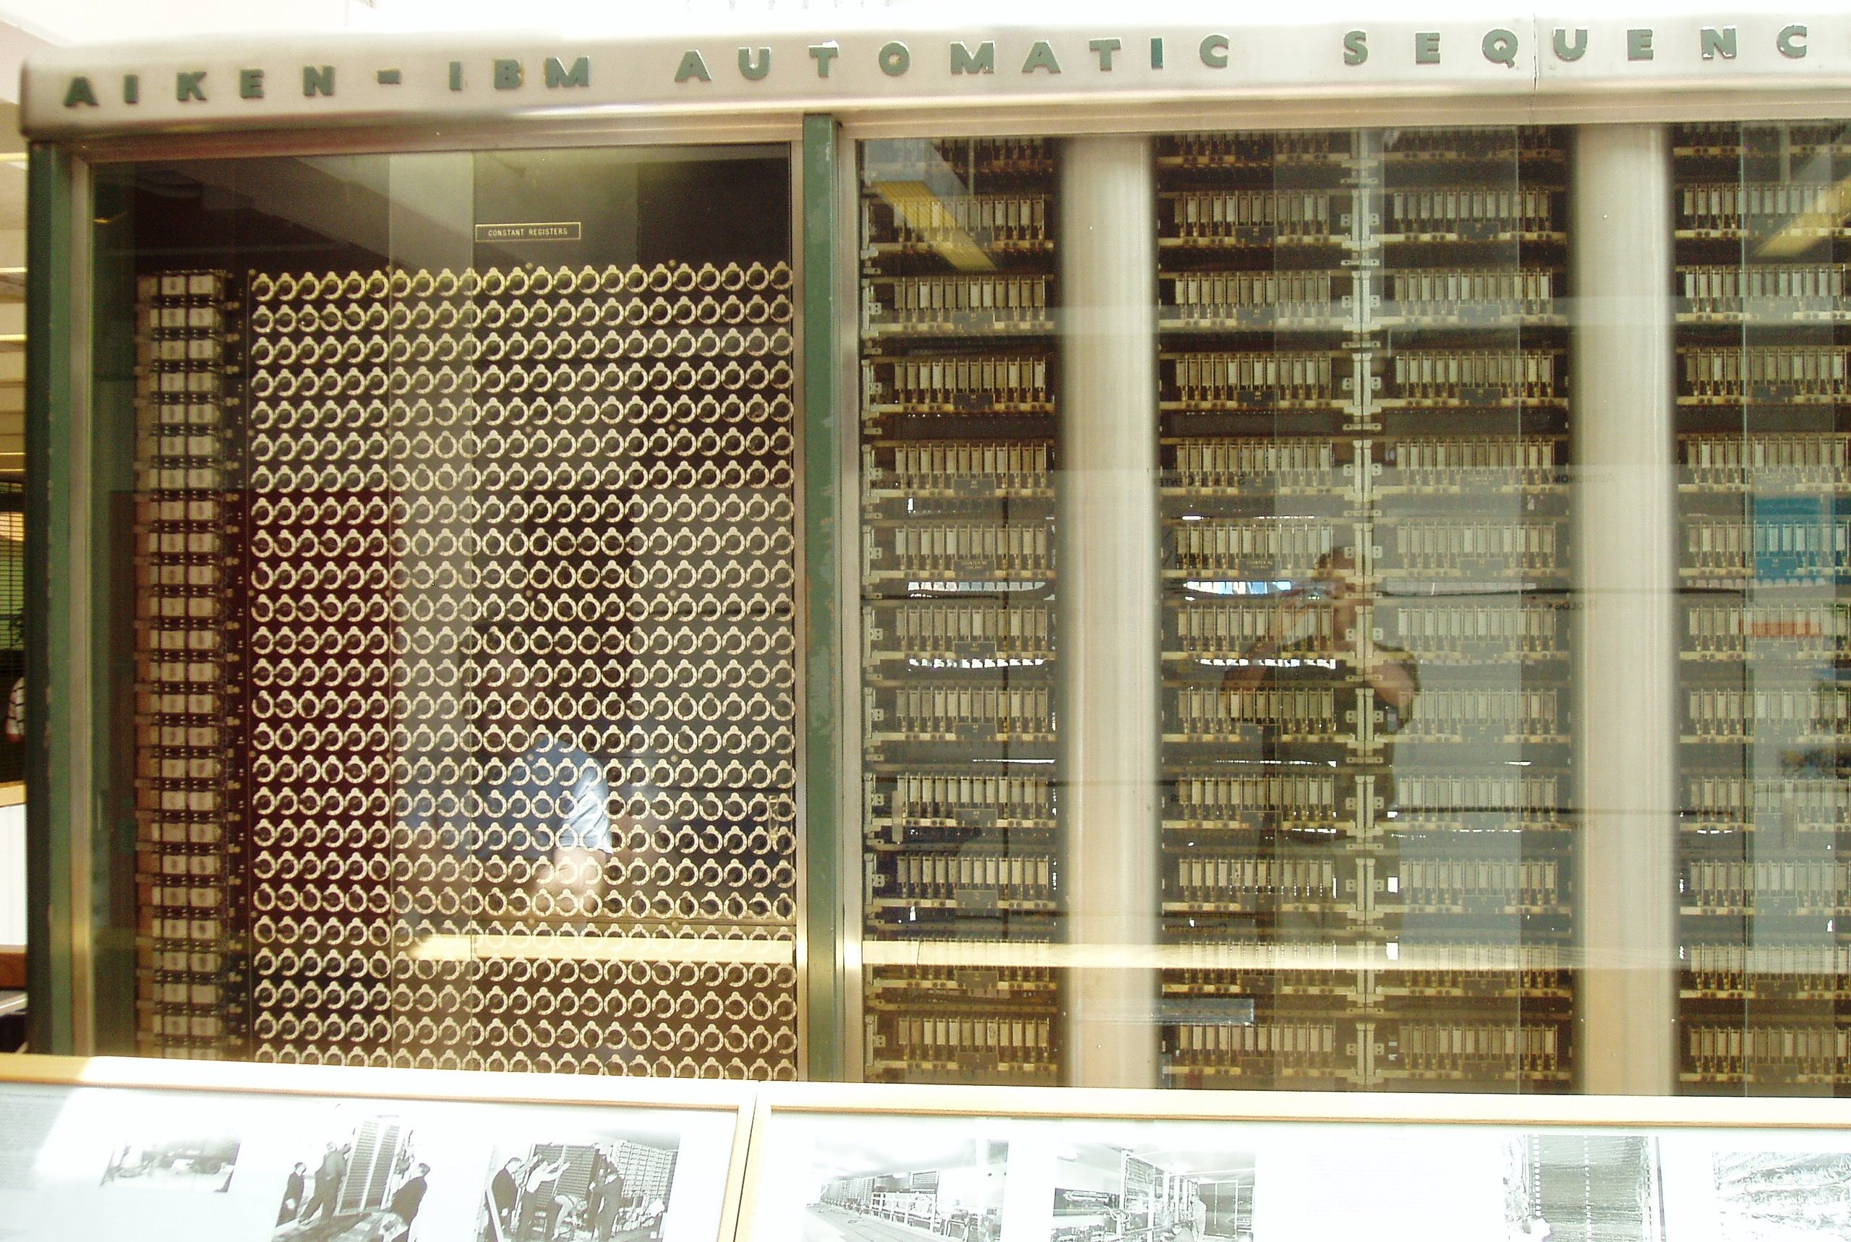
Harvard Mark I (1944)
Proposed by Howard Aiken at Harvard, and funded and built by IBM
Mostly mechanical with some electrically controlled relays and gears
Weighed 5 tons and had 750,000 components
Stored 72 numbers each of 23 decimal digits
Speed: adds 0.3s, multiplies 6s, divide 15s, trig >1 minute
Instructions on paper tape (2-address format)
Could run long programs automatically
Loops by gluing paper tape into loops
No conditional branch
Although mentioned Babbage in proposal, was more limited than analytical engine
[Waldir, Creative Commons BY-SA 3.0 ]

Slide 37
ENIAC (1946)
First electronic general-purpose computer
Construction started in secret at UPenn Moore School of Electrical Engineering during WWII to calculate firing tables for US Army, designed by Eckert and Mauchly
17,468 vacuum tubes
Weighed 30 tons, occupied 1800 sq ft, power 150kW
Twelve 10-decimal-digit accumulators
Had a conditional branch!
Programmed by plugboard and switches, time consuming!
Purely electronic instruction fetch and execution, so fast
10-digit x 10-digit multiply in 2.8ms (2000x faster than Mark-1)
As a result of speed, it was almost entirely I/O bound
As a result of large number of tubes, it was often broken (5 days was longest time between failures)

Slide 38

ENIAC
Changing the program could take days!
[Public Domain, US Army Photo]

Slide 39
EDVAC
ENIAC team started discussing stored-program concept to speed up programming and simplify machine design
John von Nuemann was consulting at UPenn and typed up ideas in “First Draft of a report on EDVAC”
Herman Goldstine circulated the draft June 1945 to many institutions, igniting interest in the stored-program idea
But also, ruined chances of patenting it
Report falsely gave sole credit to von Neumann for the ideas
Maurice Wilkes was excited by report and decided to come to US workshop on building computers
Later, in 1948, modifications to ENIAC allowed it to run in stored-program mode, but 6x slower than hardwired
Due to I/O limitations, this speed drop was not practically significant and improvement in productivity made it worthwhile
EDVAC eventually built and (mostly) working in 1951
Delayed by patent disputes with university

Slide 40
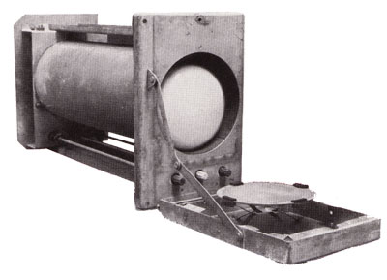
Manchester SSEM “Baby” (1948)
Manchester University group build small-scale experimental machine to demonstrate idea of using cathode-ray tubes (CRTs) for computer memory instead of mercury delay lines
Williams-Kilburn Tubes were first random access electronic storage devices
32 words of 32-bits, accumulator, and program counter
Machine ran world’s first stored-program in June 1948
Led to later Manchester Mark-1 full-scale machine
Mark-1 introduced index registers
Mark-1 commercialized by Ferranti
[Piero71, Creative Commons BY-SA 3.0 ]
Williams-Kilburn Tube Store

Slide 41
Cambridge EDSAC (1949)
Maurice Wilkes came back from workshop in US and set about building a stored-program computer in Cambridge
EDSAC used mercury-delay line storage to hold up to 1024 words (512 initially) of 17 bits (+1 bit of padding in delay line)
Two’s-complement binary arithmetic
Accumulator ISA with self-modifying code for indexing
David Wheeler, who earned the world’s first computer science PhD, invented the subroutine (“Wheeler jump”) for this machine
Users built a large library of useful subroutines
UK’s first commercial computer, LEO-I (Lyons Electronic Office), was based on EDSAC, ran business software in 1951
Software for LEO was still running in the 1980s in emulation on ICL mainframes!
EDSAC-II (1958) was first machine with microprogrammed control unit

Slide 42
Commercial computers: BINAC (1949) and UNIVAC (1951)
Eckert and Mauchly left U.Penn after patent rights disputes and formed the Eckert-Mauchly Computer Corporation
World’s first commercial computer was BINAC with two CPUs that checked each other
BINAC apparently never worked after shipment to first (only) customer
Second commercial computer was UNIVAC
Used mercury delay-line memory, 1000 words of 12 alpha characters
Famously used to predict presidential election in 1952
Eventually 46 units sold at >$1M each
Often, mistakingly called the IBM UNIVAC

Slide 43
IBM 701 (1952)
IBM’s first commercial scientific computer
Main memory was 72 William’s Tubes, each 1Kib, for total of 2048 words of 36 bits each
Memory cycle time of 12µs
Accumulator ISA with multipler/quotient register
18-bit/36-bit numbers in sign-magnitude fixed-point
Misquote from Thomas Watson Sr/Jr:
“I think there is a world market for maybe five computers”
Actually TWJr said at shareholder meeting:
“as a result of our trip [selling the 701], on which we expected to get orders for five machines, we came home with orders for 18.”

Slide 44
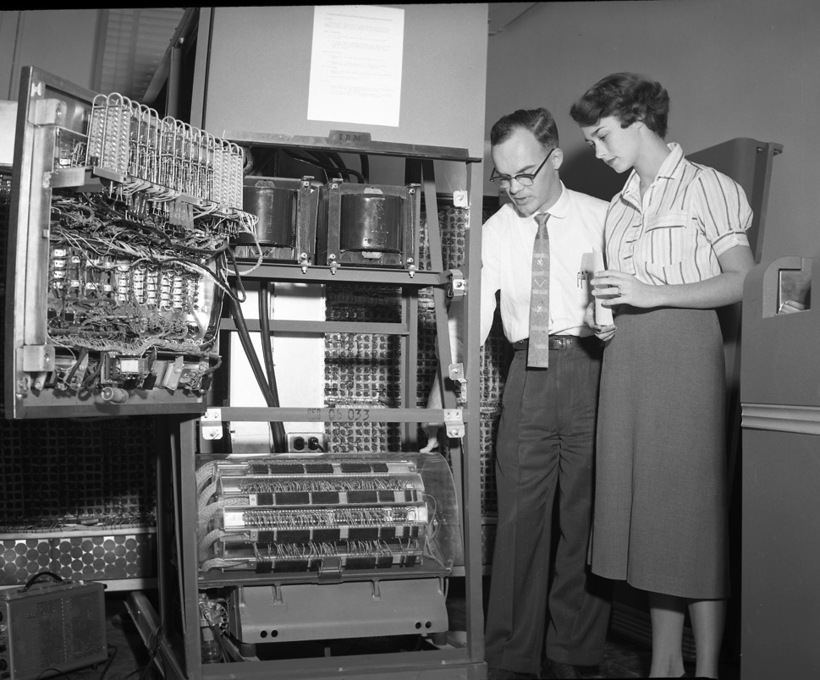
IBM 650 (1953)
The first mass-produced computer
Low-end system with drum-based storage and digit serial ALU
Almost 2,000 produced
[Cushing Memorial Library and Archives, Texas A&M,
Creative Commons Attribution 2.0 Generic ]

Slide 45
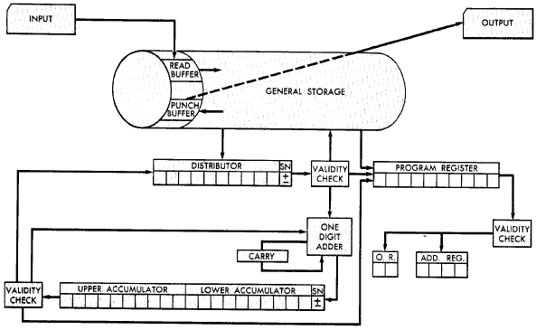
IBM 650 Architecture
Magnetic Drum (1,000 or 2,000
10-digit decimal words)
Active instruction (including next program counter)
Digit-serial ALU
20-digit accumulator
[From 650 Manual, © IBM]

Slide 46
IBM 650 Instruction Set
Address and data in 10-digit decimal words
Instructions encode:
Two-digit opcode encoded 44 instructions in base instruction set, expandable to 97 instructions with options
Four-digit data address
Four-digit next instruction address
Programmer’s arrange code to minimize drum latency!
Special instructions added to compare value to all words on track

Slide 47
Early Instruction Sets
Very simple ISAs, mostly single-address accumulator-style machines, as high-speed circuitry was expensive
Based on earlier “calculator” model
Over time, appreciation of software needs shaped ISA
Index registers (Kilburn, Mark-1) added to avoid need for self-modifying code to step through array
Over time, more index registers were added
And more operations on the index registers
Eventually, just provide general-purpose registers (GPRs) and orthogonal instruction sets
But some other options explored…

Slide 48
Burrough’s B5000 Stack Architecture: Robert Barton, 1960
Hide instruction set completely from programmer using high-level language (ALGOL)
Use stack architecture to simplify compilation, expression evaluation, recursive subroutine calls, interrupt handling,…

Slide 49
Evaluation of Expressions
(a + b * c) / (a + d * c - e)
/
+
-
a
*
+
e
b
c
a
*
d
c
c
*
b * c
b
Reverse Polish
a b c * + a d c * + e - /
a
Evaluation Stack
push a
push b
push c
multiply

Slide 50
Evaluation of Expressions
(a + b * c) / (a + d * c - e)
/
+
-
a
*
+
e
b
c
a
*
d
c
b * c
Reverse Polish
a b c * + a d c * + e - /
+
a + b * c
a
Evaluation Stack
add

Slide 51
IBM’s Big Bet: 360 Architecture
By early 1960s, IBM had several incompatible families of computer:
701 → 7094
650 → 7074
702 → 7080
1401 → 7010
Each system had its own
Instruction set
I/O system and secondary storage (magnetic tapes, drums and disks)
assemblers, compilers, libraries,...
market niche (business, scientific, real time, ...)

Slide 52
IBM 360 : Design Premises Amdahl, Blaauw and Brooks, 1964
The design must lend itself to growth and successor machines
General method for connecting I/O devices
Total performance - answers per month rather than bits per microsecond → programming aids
Machine must be capable of supervising itself without manual intervention
Built-in hardware fault checking and locating aids to reduce down time
Simple to assemble systems with redundant I/O devices, memories etc. for fault tolerance
Some problems required floating-point larger than 36 bits

Slide 53
Stack versus GPR Organization Amdahl, Blaauw and Brooks, 1964
1. The performance advantage of push-down stack organization is derived from the presence of fast registers and not the way they are used.
2.“Surfacing” of data in stack which are “profitable” is approximately 50% because of constants and common subexpressions.
3. Advantage of instruction density because of implicit addresses is equaled if short addresses to specify registers are allowed.
4. Management of finite-depth stack causes complexity.
5. Recursive subroutine advantage can be realized only with the help of an independent stack for addressing.
6. Fitting variable-length fields into fixed-width word is awkward.

Slide 54
IBM 360: A General-Purpose Register (GPR) Machine
Processor State
16 General-Purpose 32-bit Registers
may be used as index and base register
Register 0 has some special properties
4 Floating Point 64-bit Registers
A Program Status Word (PSW)
PC, Condition codes, Control flags
A 32-bit machine with 24-bit addresses
But no instruction contains a 24-bit address!
Data Formats
8-bit bytes, 16-bit half-words, 32-bit words, 64-bit double-words
The IBM 360 is why bytes are 8-bits long today!

Slide 55
IBM 360: Initial Implementations
Model 30 . . . Model 70
Storage 8K - 64 KB 256K - 512 KB
Datapath 8-bit 64-bit
Circuit Delay 30 nsec/level 5 nsec/level
Local Store Main Store Transistor Registers
Control Store Read only 1sec Conventional circuits
IBM 360 instruction set architecture (ISA) completely hid the underlying technological differences between various models.
Milestone: The first true ISA designed as portable hardware-software interface!
With minor modifications it still survives today!

Slide 56
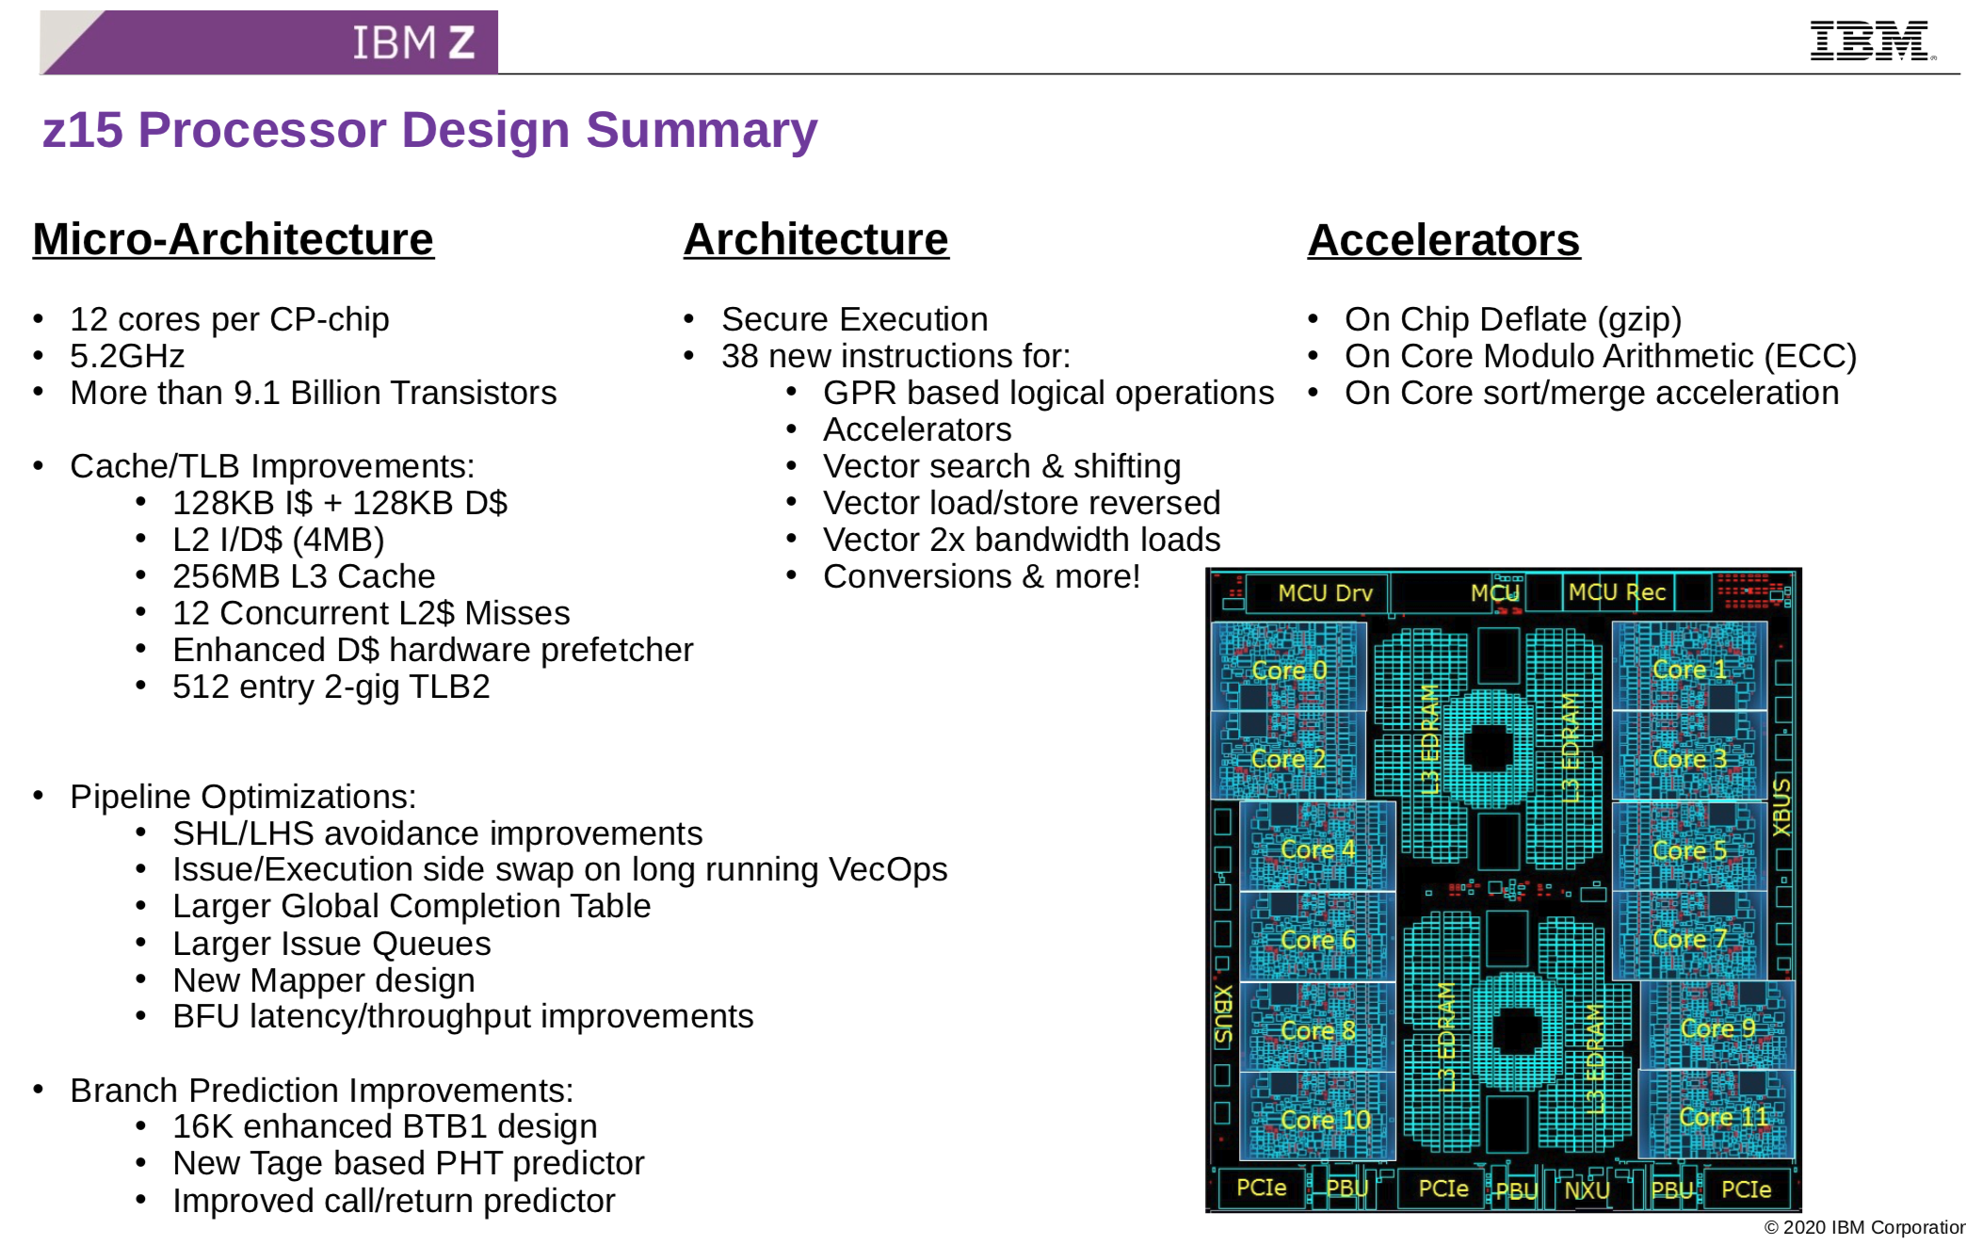
IBM Mainframes survive until today
[z15, 2020, 14nm technology, 17 layers of metal, 696 sq mm]

Slide 57
And in conclusion …
Computer Architecture >> ISAs and RTL
CSx52 is about interaction of hardware and software, and design of appropriate abstraction layers
Computer architecture is shaped by technology and applications
History provides lessons for the future
Computer Science at the crossroads from sequential to parallel computing
Salvation requires innovation in many fields, including computer architecture
Read Chapter 1 & Appendix A for next time! (5th edition)

Slide 58
Acknowledgements
These slides contain material developed and copyright by:
Arvind (MIT)
Krste Asanovic (MIT/UCB)
Joel Emer (Intel/MIT)
James Hoe (CMU)
John Kubiatowicz (UCB)
David Patterson (UCB)
MIT material derived from course 6.823
UCB material derived from course CS252

